Slide 1
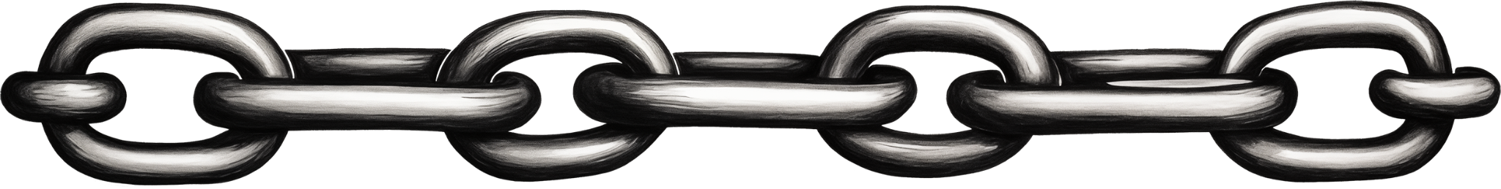
DISCOVERING the
DARK SIDE of FIAT
My First Bitcoin | Chapter 3

Slide 2
3.0 Drawbacks of the Fiat System
My First Bitcoin | Chapter 3

Slide 3
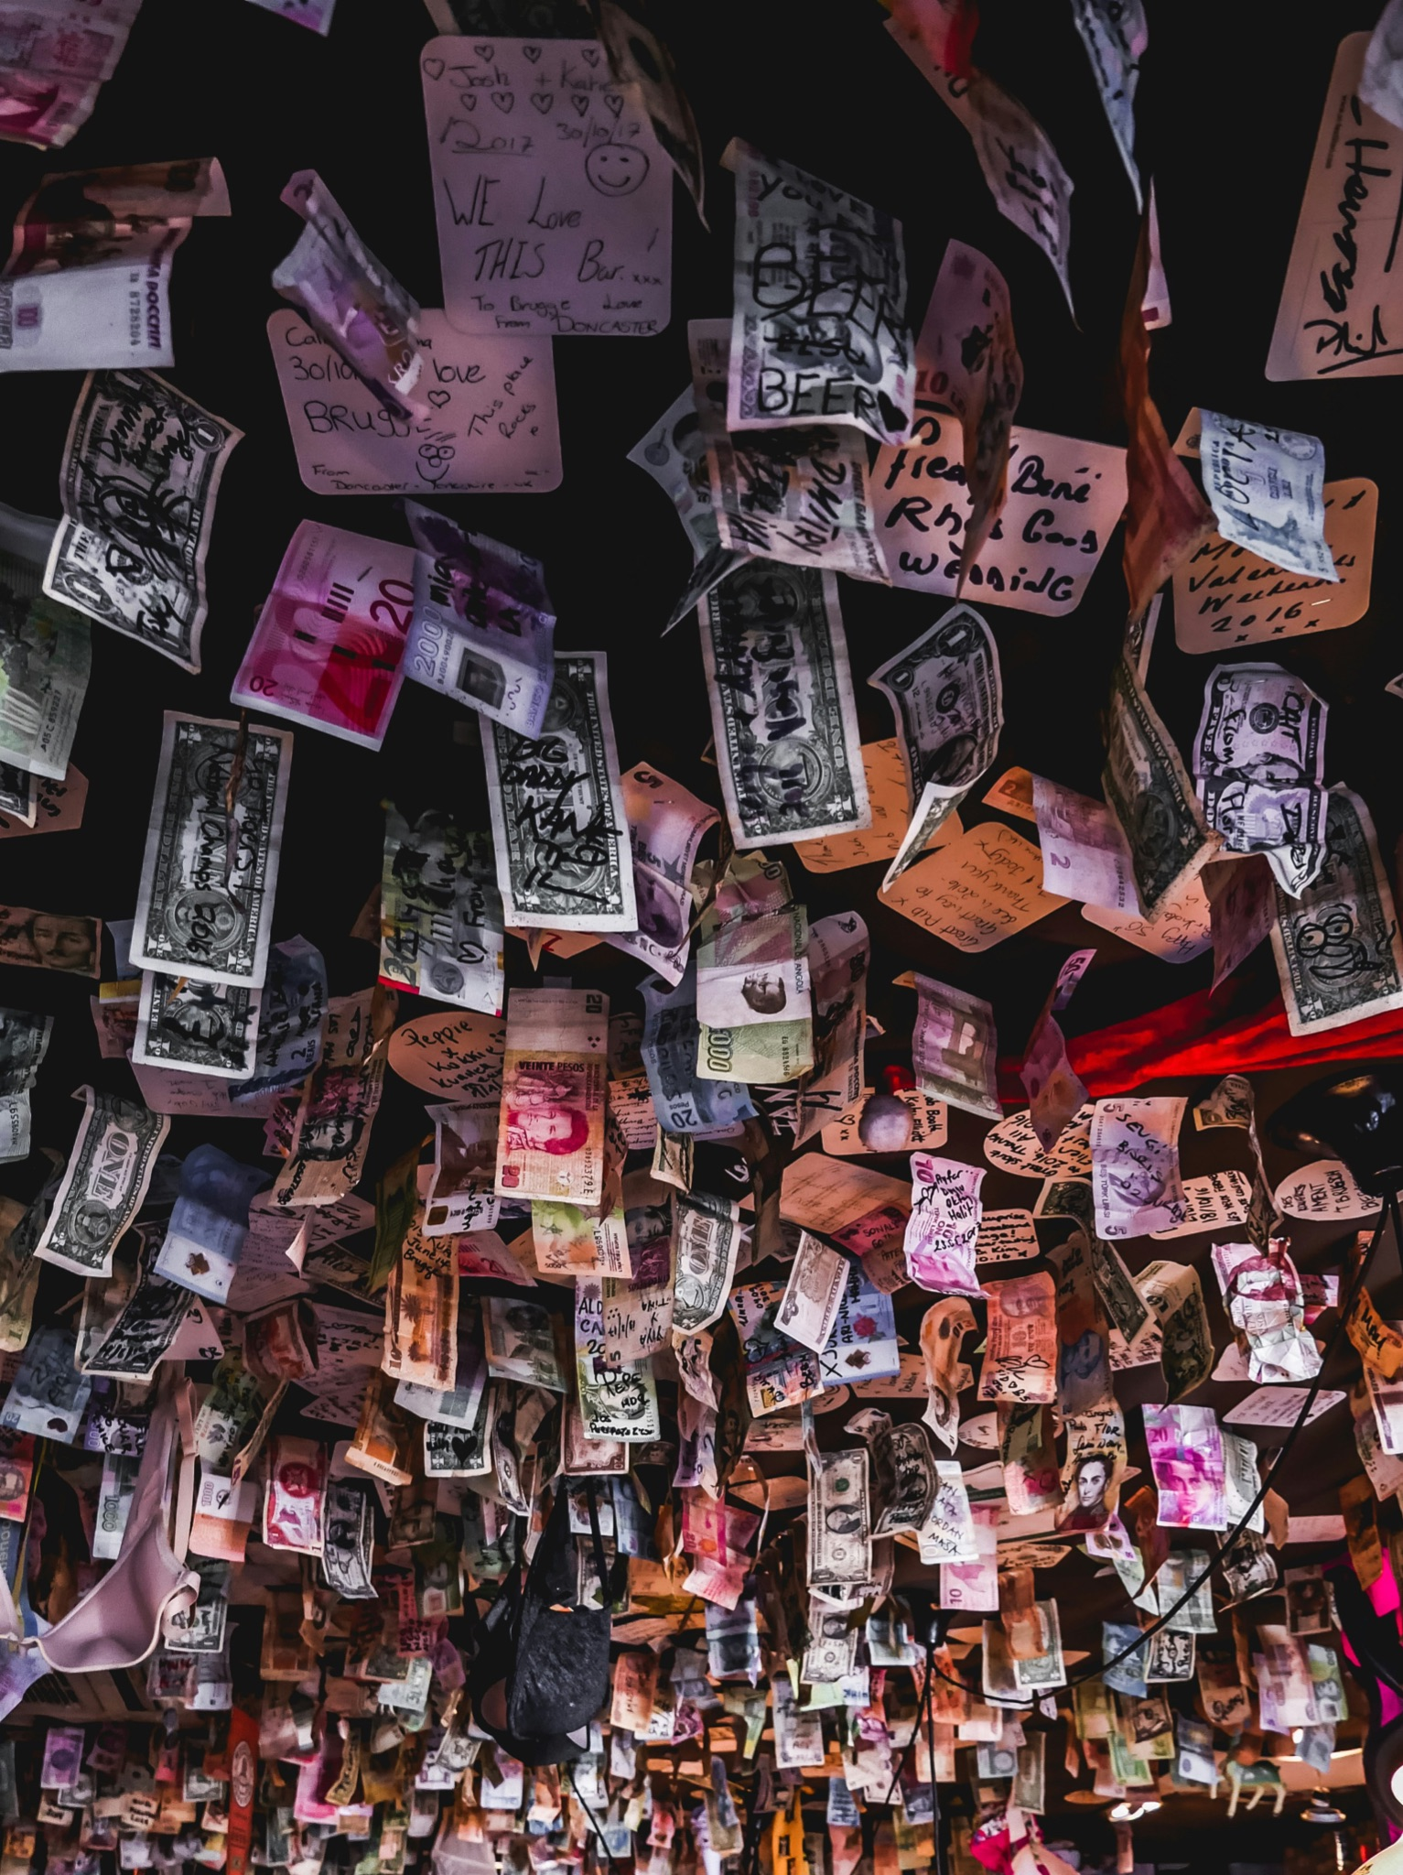
What is the fiat system?
A monetary system based on government-issued currency.
Not backed by a physical commodity like gold or silver.
Value is based on the faith and credit of the government that issued it.
Benefits include stability and flexibility, but with significant drawbacks.
Fiat perpetuates power dynamics and exacerbates wealth inequality.
Photo by Jonny McKenna on Unsplash

Slide 4

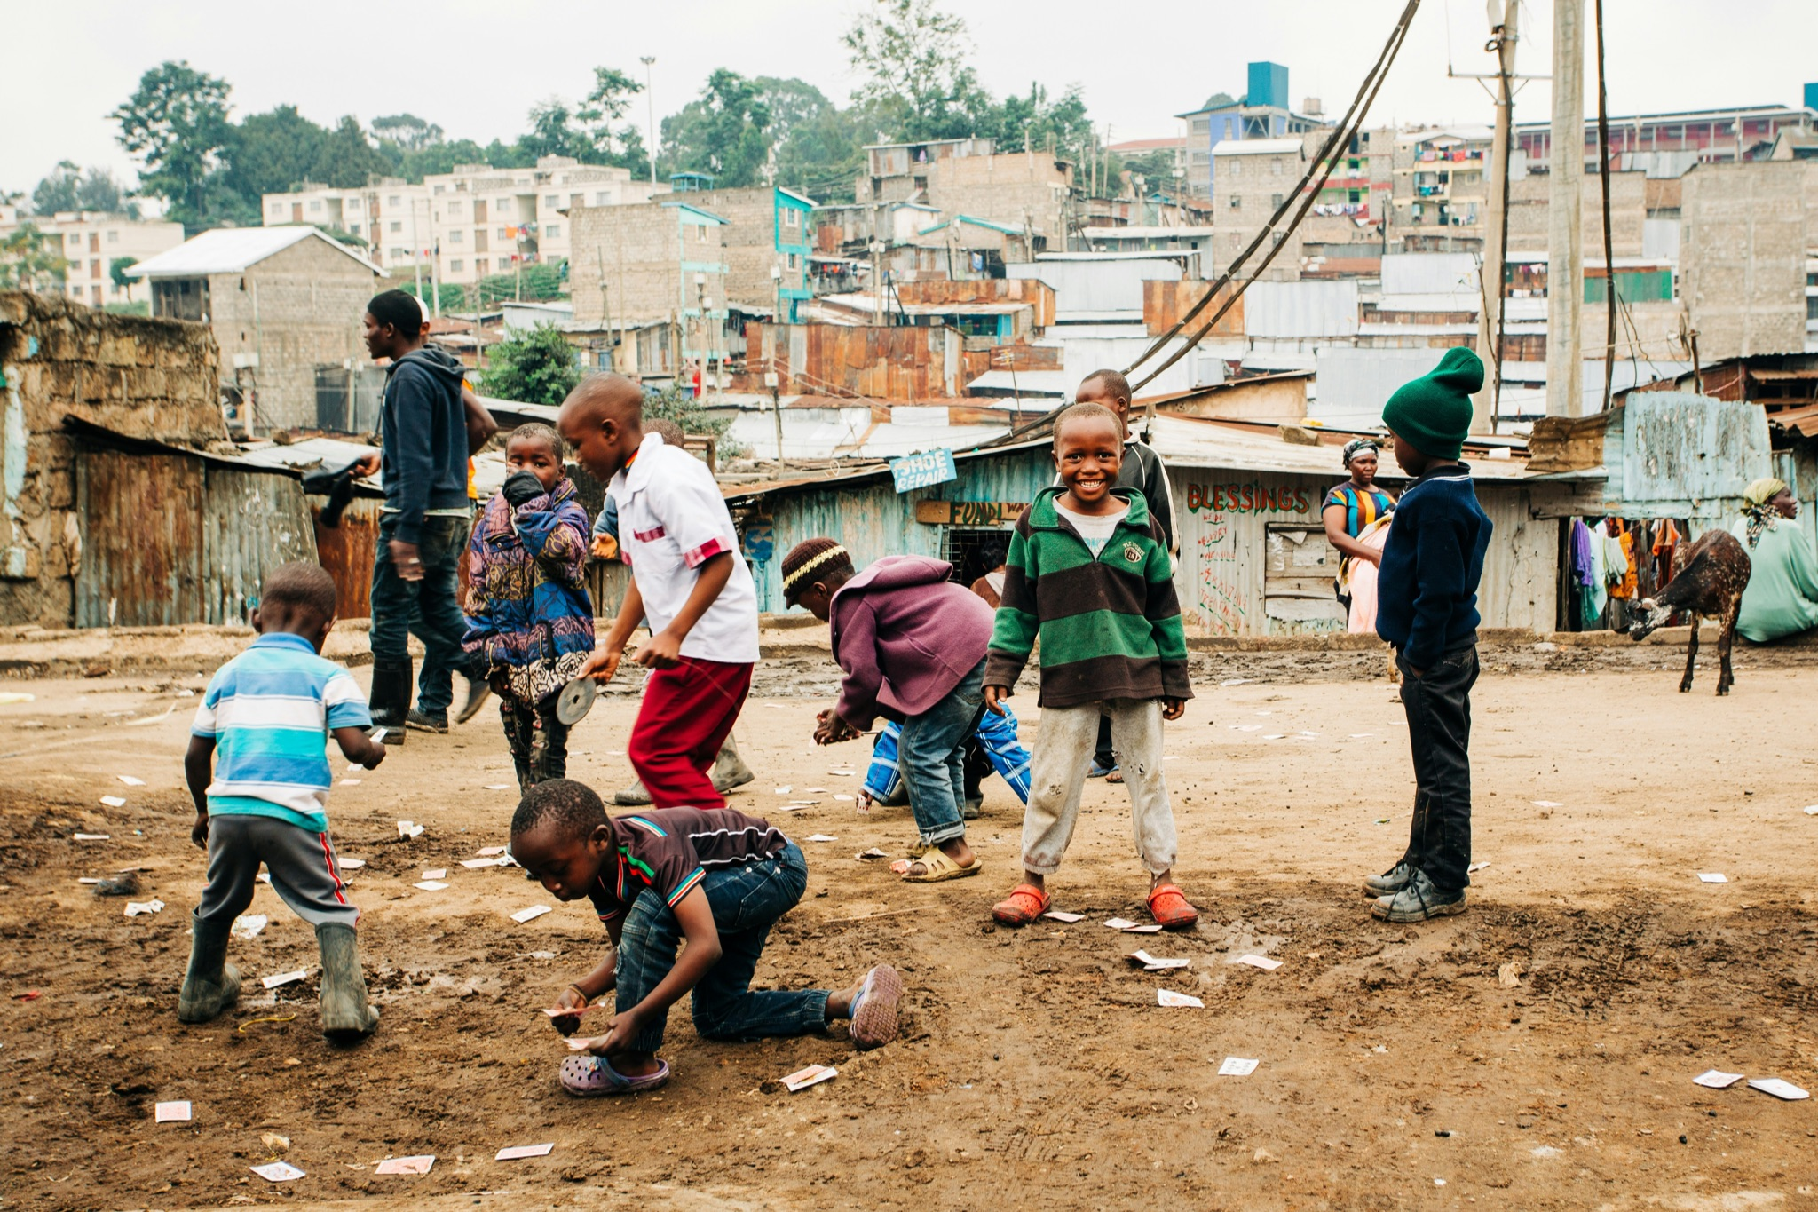
What is the fiat system? (…)
Inflation and debasement lead to a reduction in the purchasing power of fiat currencies, disproportionately affecting the middle and lower classes.
Allows for the accumulation of debt on a massive scale, which must be paid back with interest, placing a significant burden on the economy.
Future generations are often left to bear the consequences.
Photo by Max Böhme on Unsplash
Photo by Bennett Tobias on Unsplash

Slide 5

What is inflation?
What is purchasing power?
What is debasement?
The increase in the general price of goods and services over time.
The reduction in purchasing power of a currency.
A measure of how much you can buy with your money.
Reduction in value by increasing supply or decreasing quality of a currency.

Slide 6
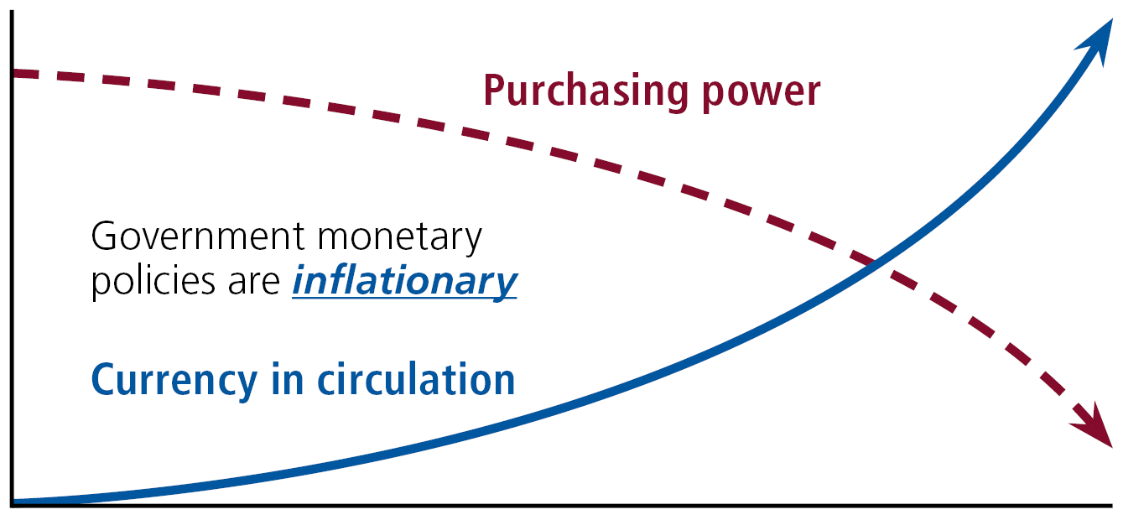

Slide 7


Example from recent history
During the 2008 financial crisis, the US government bailed out corporations such as AIG, Citigroup, and Bank of America.
Bailouts were paid for with taxpayer money.
The interests of the wealthy were protected, leaving ordinary citizens to bear the burden of economic hardship.
The top 1% of income earners received 95% of the income gains and the bottom 90% experienced a decline in income.
Photo by Miquel Parera on Unsplash
Photo by Steve Knutson on Unsplash

Slide 8
The impacts of inflation and debasement
According to a report by the Economic Policy Institute:
The top 1% of income earners in the U.S. have seen their income grow by 205% since 1979.
The bottom 90% have seen their income grow by only 62%.
The rich are getting richer while the poor are getting poorer.
Inflation and debasement exacerbate wealth inequality by decreasing the purchasing power of the middle and lower class, who already struggle to make ends meet.

Slide 9
The impacts of inflation and debasement (…)
Giving governments and central banks control over the money supply perpetuates power dynamics.
Control is abused to benefit those in power at the expense of the majority.
Governments and central banks manipulate interest rates to favor certain groups or industries over others.
Monetary policy is used to stimulate economic growth or control inflation, but these policies have unintended consequences that disproportionately affect the middle and lower classes.

Slide 10
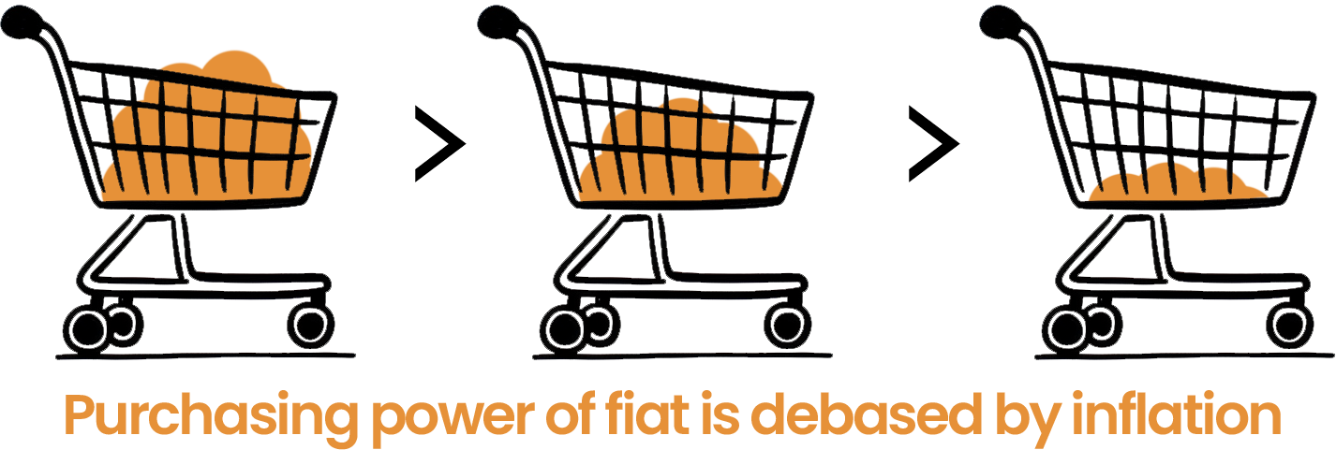
The impacts of inflation and debasement (…)
Enable the accumulation of debt on a massive scale.
Governments and corporations borrow money with relative ease, but the debt must be paid back with interest.
This interest can become a significant burden on the economy.

Slide 11

Considering the drawbacks
Future generations are often left to bear the consequences.
While the fiat system has its benefits, it is important to recognize its drawbacks and consider alternatives like Bitcoin.
Understanding the power dynamics and wealth inequality perpetuated by the fiat system can help us work towards creating a more equitable and transparent financial system for all.
Photo by Adam Thomas on Unsplash

Slide 12
3.1 Biggest Threats to Your Money
My First Bitcoin | Chapter 3

Slide 13
Class exercise
Volunteers will be allocated a random amount of play money. This represents the money supply in a society. The exercise mimics real-life situations where unequal distribution of resources and opportunities occur, highlighting the inherent randomness and unfairness in many situations.
Write down the total money supply in a chart resembling the one below:
Round | Money supply | Winning bid
1
2
3

Slide 14
Class exercise (…)
The teacher will auction off a 1,000 satoshi prize. To win the auction, you will need to make the highest bid using your allocation of play money. Record the winning bid next to the money supply.
The teacher will then add a significant amount of play money to the total supply. This represents an increase in the money supply in an economy. Later, you will learn how money supply is added or reduced in an economy.
The teacher will hold a second auction using the same process as before. Record the winning bid next to the money supply on the chart.
The teacher will then repeat the auction a third time.

Slide 15
Conclusions
How did the increase in the money supply affect the winning bids?
What is the relationship between the money supply and inflation?
How is the money supply relevant in the real world?
What other factors that can affect the prices of goods and services?
Understanding how inflation impacts not only individuals, but entire communities, can help to inform decisions about saving and spending, while recognizing the challenges posed by economic conditions.

Slide 16
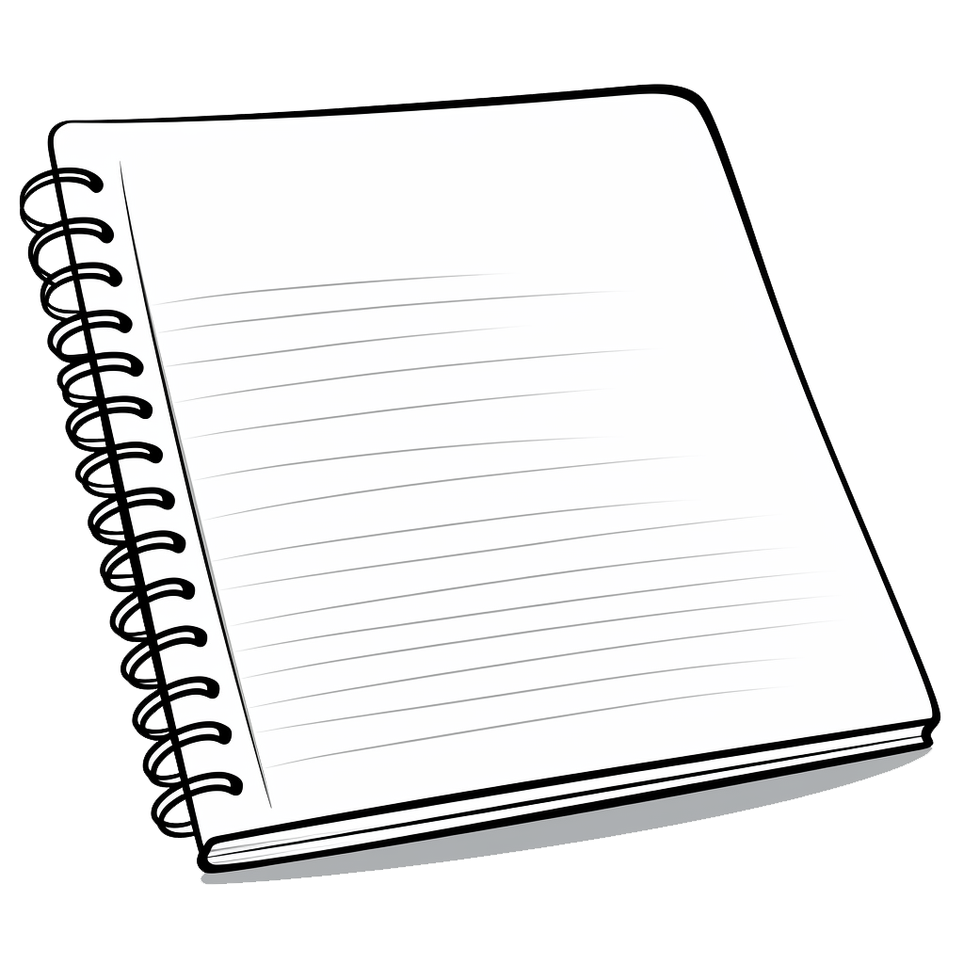
Example
Jaime is a college student who lives in a small apartment. He works part-time at a coffee shop to pay for his living expenses and tuition.
As soon as he starts living independently, Jaime learns to manage his own ledger.
At the beginning of the year, Jaime budgets $10,000 for his living expenses, including rent, food and other necessities.
A ledger is a record of all of your transactions. Keeping a ledger can help you keep track what you are earning and spending.
A budget is an estimate of income and expenditures for a set period of time.

Slide 17
Example (…)
These were Jaime’s transactions for January:
Date | Description | Amount | Type | Balance
01/01/2023 | Starting balance |  |  | $1,600.00
01/01/2023 | Rent for January | $800.00 | Debit | $800.00
01/05/2023 | Groceries | $100.00 | Debit | $700.00
01/15/2023 | Part-time paycheck | $500.00 | Credit | $1,200.00
01/20/2023 | Gas for car | $350.00 | Debit | $850.00
01/30/2023 | Textbooks | $150.00 | Debit | $650.00

Slide 18
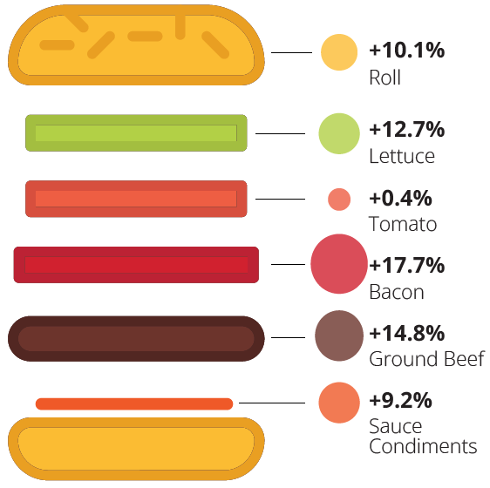
Example (…)
Twelve months later, while having lunch, Jaime notices that his budget is not stretching as far as it used to.
He realizes that the prices of the goods and services he needs have increased significantly over the past year, and he wonders why.
Then he sees this image and can’t believe his eyes!
Year-over-year change in price of ingredients of a hamburger

Slide 19
Example (…)
The cost of each ingredient in the burger increased, leading to an overall decrease in Jaime’s purchasing power.
Jaime’s disciplined use of a ledger has clearly shown him how his annual purchasing power has decreased over time.
Jaime knows that he needs to budget an additional $1,000 for the same basket of goods and services that he purchased the previous year.
This means that his purchasing power has decreased by $1,000, as he now has to spend more money to buy the same goods and services.

Slide 20
Example (…)
These were Jaime’s cost of each item in the basket in the first year and the second year, as well as the percentage increase in price:
Item | Cost – Year 1 | Cost – Year 2 | % increase
Rent | $4,000 | $4,500 | 12.5%
Groceries | $2,000 | $2,300 | 15%
Other necessities | $4,000 | $4,200 | 5%
Total | $10,000 | $11,000 | 10%

Slide 21
Example (…)
According to the U.S. Bureau of Labor Statistics, today’s prices are actually 30.39 times as high as average prices in 1913. Meaning that a dollar today only buys about 3% of what a dollar bought back then.
Now, imagine someone gave Jaimie a time-travel choice: either take $100 in 1913, or wait until 2024 to receive a mere $3.
It’s like deciding between a shopping spree in the past or grabbing just a couple of small treats today.
The difference is huge, and it highlights how much value the dollar has lost over the years!

Slide 22
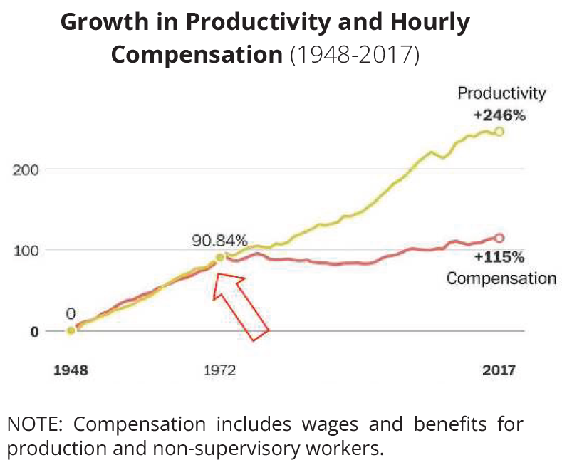
Example (…)
This disincentivizes saving. It’s more advantageous to spend money now before its value decreases. This hinders people’s ability to plan for the future.
As shown in the graph, salary growth year over year in the U.S. has remained stagnant for the average citizen since around 1971, this means that most people aren’t receiving raises at the same rate as their currency loses value, despite having to work harder.

Slide 23
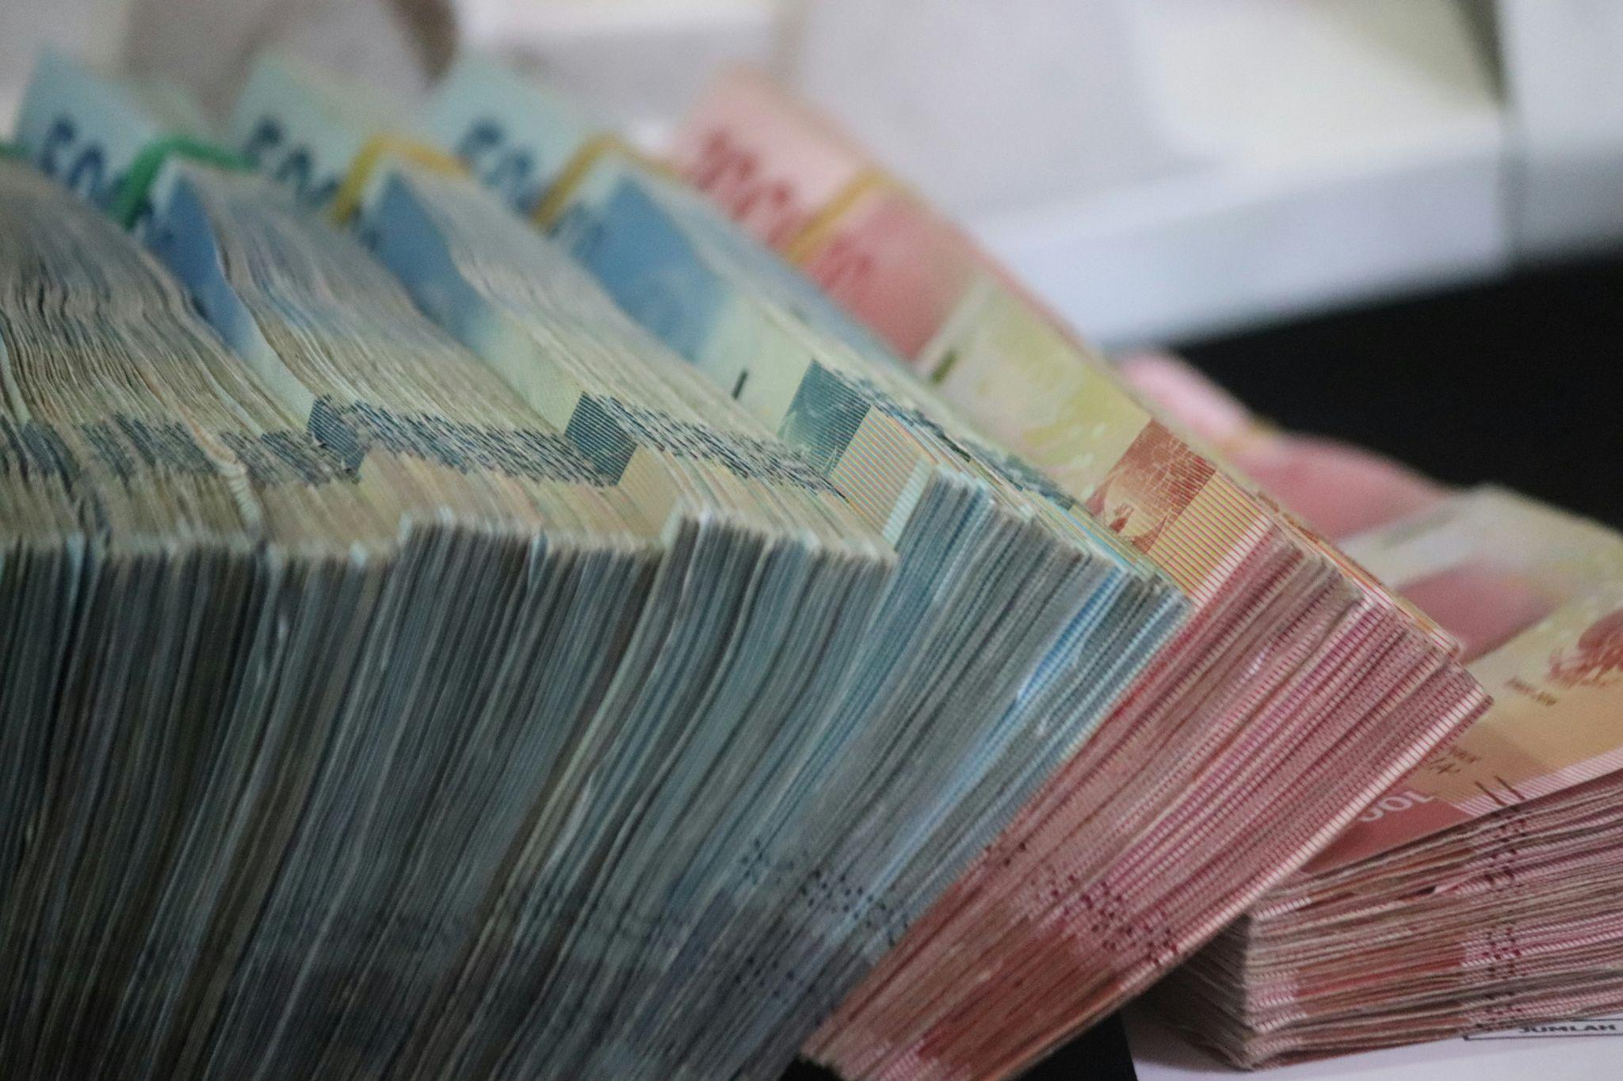
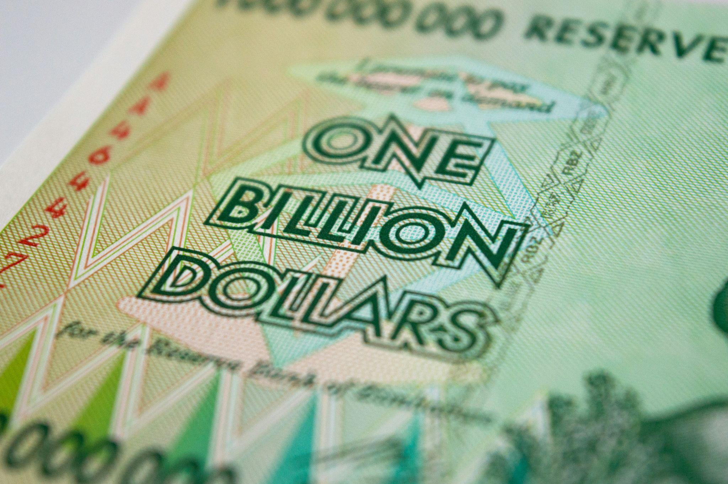
Further examples
Zimbabwe experienced hyperinflation in the late 2000’s.
The country’s economy was hit by a combination of political instability, economic mismanagement and external factors such as drought and sanctions.
As a result, the value of the Zimbabwean dollar plummeted, and the government was forced to print more money.
Photo by Mufid Majnun on Unsplash
Photo by Rob on Unsplash

Slide 24
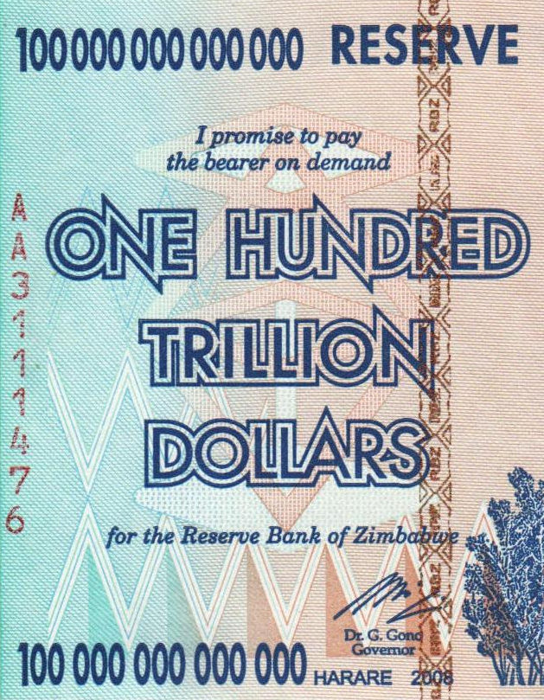
Further examples (…)
In 2008 the 100 Trillion dollar bill was introduced in Zimbabwe.
Because of hyperinflation, it was worth only a few U.S. dollars at the time.
Despite its high face value, the bill was not enough to buy basic necessities and people had to carry large bundles of cash to make everyday purchases.
Photo by Mo_Cuishle on Wikimedia Commons

Slide 25
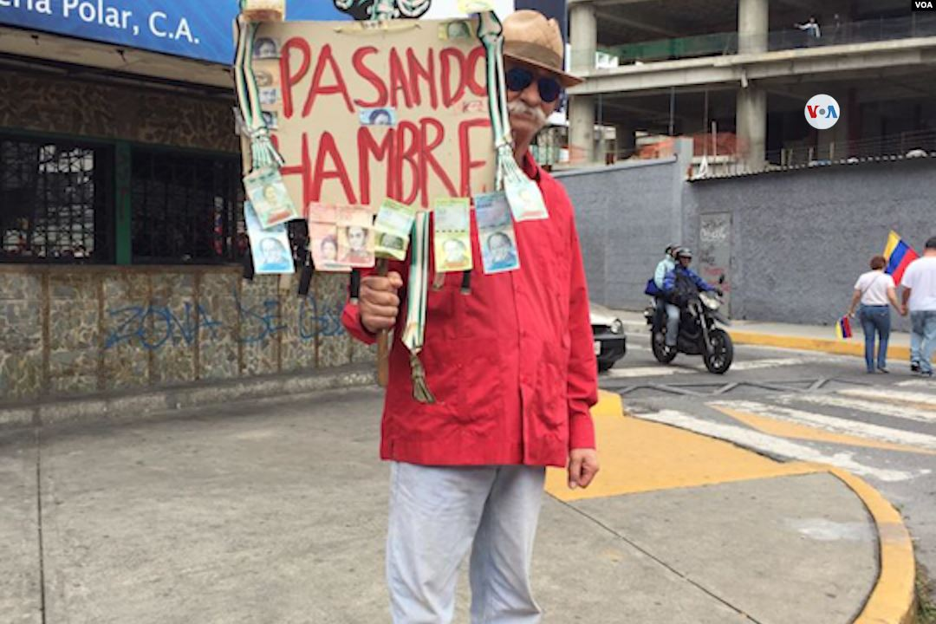
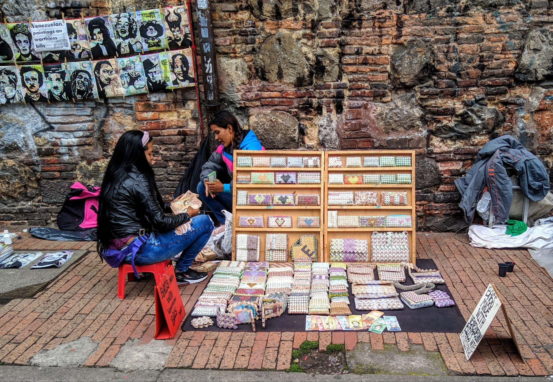
Further examples (…)
In Venezuela, poor economic policies and excessive money printing caused the bolivar to hyperinflate, leading to widespread poverty, food shortages, and political instability.
The 2008 financial crisis exemplified the failure of a fiat system. Irresponsible lending practices, lack of oversight, and excessive money creation led to a collapse in the housing market, massive job losses, and global economic turmoil.
Photo by VOA on Wikimedia Commons
Photo by Reg Natarajan on Wikimedia Commons

Slide 26
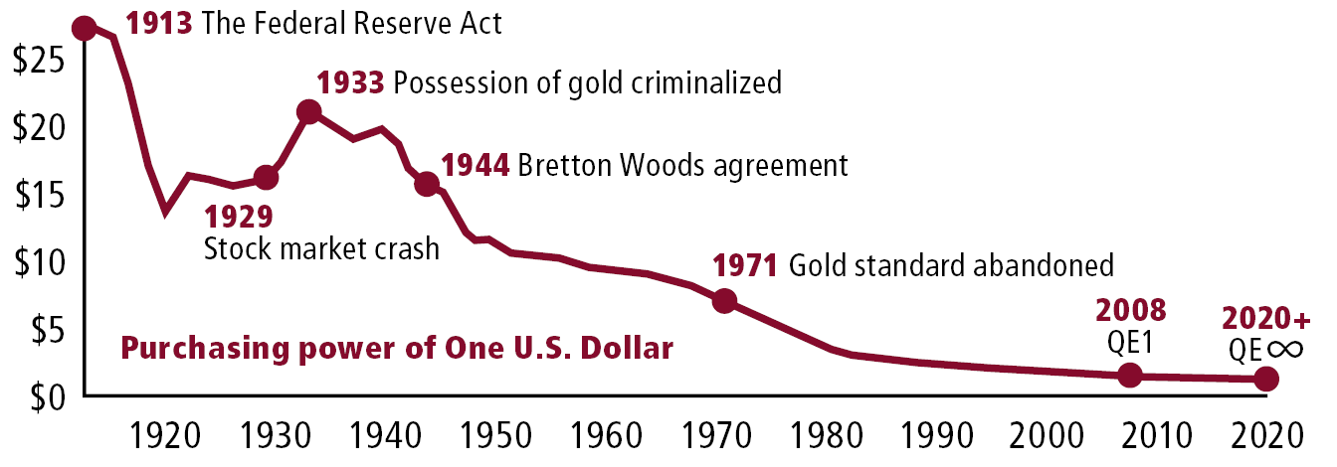
A dollar’s worth
The purchasing power of the U.S. dollar has fallen sharply over the last century, due to rising inflation and money supply.

Slide 27
A dollar’s worth (…)
1913 The Federal Reserve Act creates a central bank with the ability to manage the country’s money supply.
1929 The stock market crashes in the lead up to the Great Depression.
1933 U.S. President Roosevelt criminalizes the possession of gold.
1944 The Bretton Woods agreement establishes the gold standard and the U.S. dollar as the world’s reserve currency.
1971 The gold standard is abandoned, currencies are no longer linked to gold.
2008 Quantitative easing (QE1) begins in response to the financial crisis.
2020 U.S. money supply grows by $3.8T, equal to 20% of all dollars ever created.

Slide 28
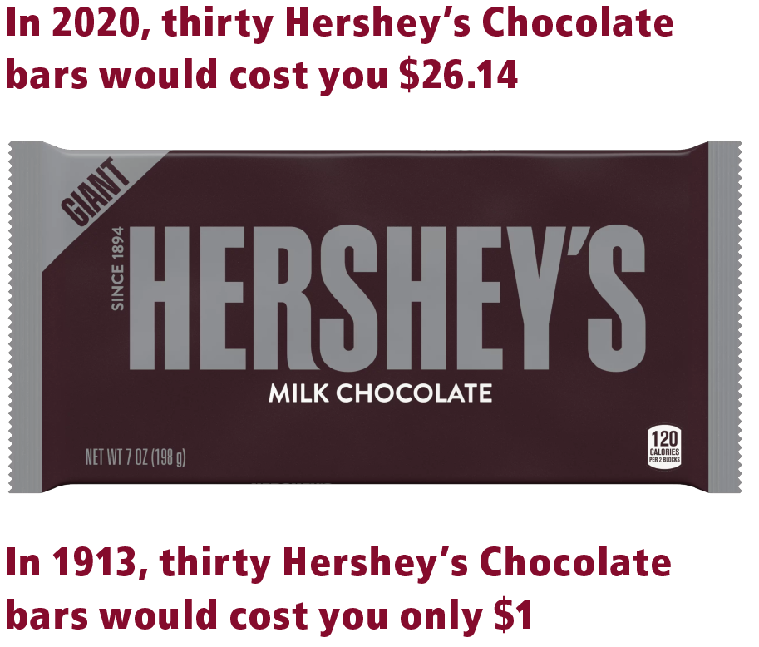
A dollar’s worth (…)
In 2020, purchasing 30 Hershey’s Chocolate bars would cost you $26.14.
However, if we go back in time to 1913, the cost for the same quantity of bars would only be $1.
This significant difference in price highlights the change in purchasing power over time and demonstrates how the value of currency has shifted over the years due to inflation.

Slide 29
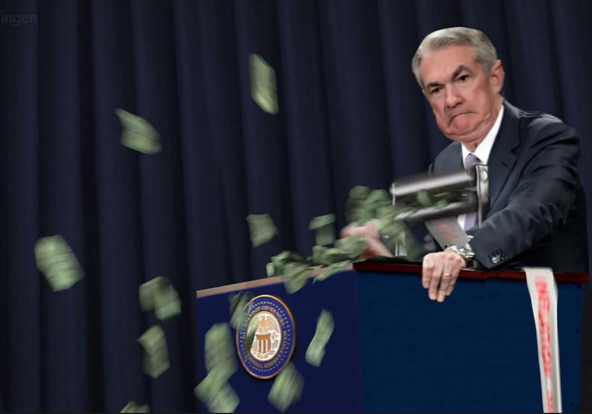
Saving money in hard times
The global economic situation, which was negatively affected by the pandemic lockdowns, has brought about challenges such as high inflation and low interest rates on savings accounts.
These conditions can make it tough to effectively save money, as inflation eats away at the value of currency over time. Even if you save today, you may end up with less purchasing power in the future.
But don’t worry! There are still ways to save money and be financially secure.
Money printer go brrr…

Slide 30
Saving money in hard times (…)
Make a budget: A budget is a plan for how you will use your money. It helps you see where you are spending too much and where you can save. Set aside some money every month for saving, and look for ways to cut back on expenses.
Start investing: Investing is a way to make your money grow over time. There are many types of investments to choose from, you can find one that fits your budget and your level of risk tolerance.
Get creative: There are many creative ways to save money. You can cut your own hair or barter with others for goods and services. Be open to trying new things and look for non-traditional solutions to your financial problems.

Slide 31
Saving money in hard times (…)
It is generally acceptable to take on debt as long as the money is used to generate income and increase purchasing power in the future. This is because borrowing money can enable investments that increase productivity and efficiency, ultimately leading to greater profits and financial stability.
For example, if a farmer takes out a loan to purchase new equipment that allows them to harvest their crops more quickly and efficiently, they may be able to generate more income and increase their purchasing power as a result.
On the other hand, if the money is used to waste resources or make unproductive investments, it can lead to financial difficulties.

Slide 32
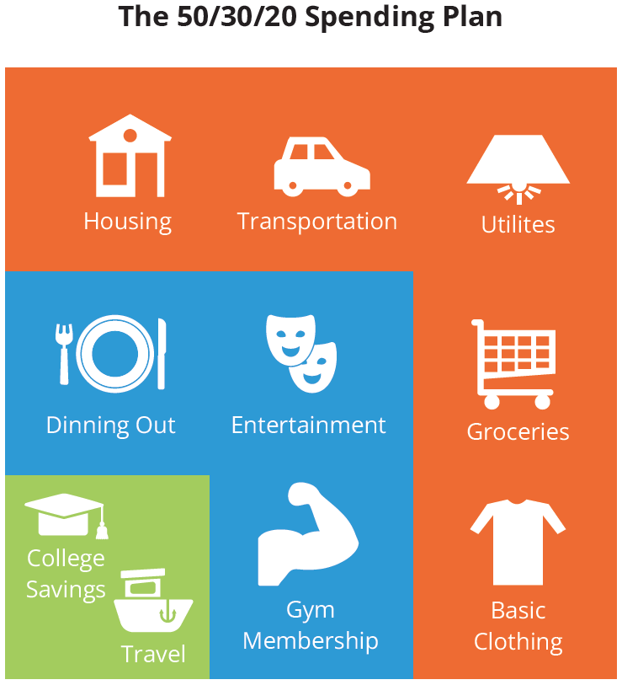
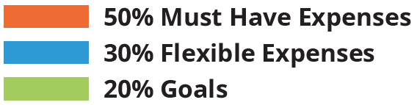
Saving money in hard times (…)
The 50/30/20 Spending Plan
By taking charge of your finances and being flexible, you will be better able to weather the storm of a tough economy and come out on top.

Slide 33
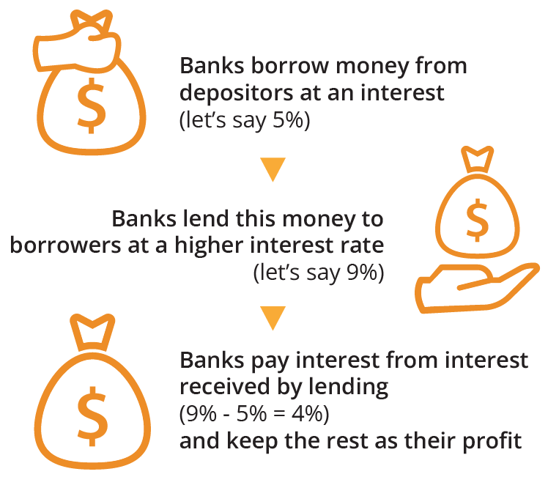
Time value of money
Have you ever wondered why banks offer so many services to their customers?
While it may seem like they are being generous, it’s important to remember that banks are businesses, and their primary goal is to make a profit.
But how do they make a profit if they are giving away money in loans?

Slide 34
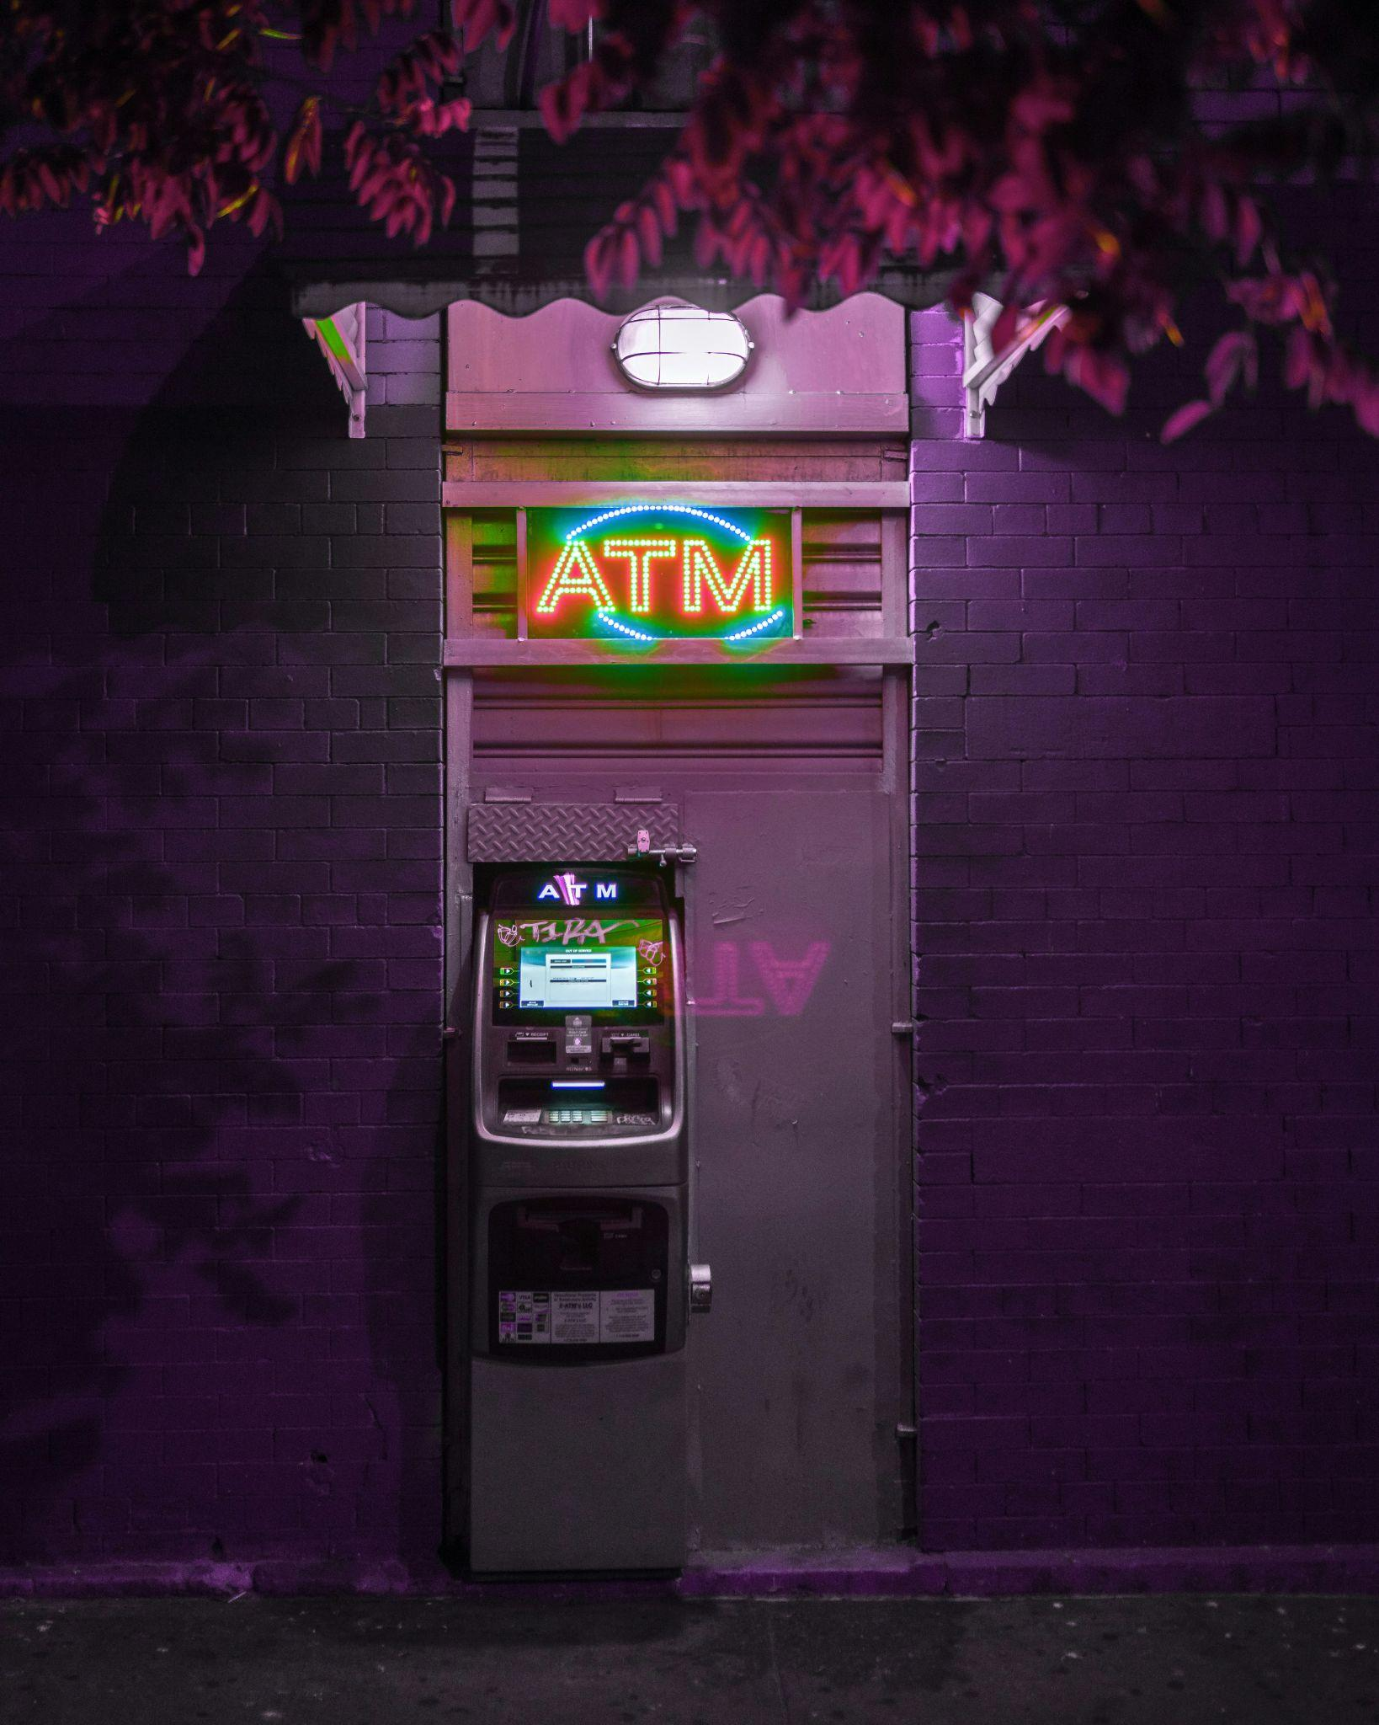
Time value of money (…)
Banks generate revenue in various ways:
Charge interest on loans.
Charge fees for ATM usage and account maintenance.
Investments, like trading securities or investing in real estate.
Keep a percentage of loans in reserve and invest or lend out the rest.
Charge fees on bank accounts.
Photo by Mirza Babic on Unsplash

Slide 35

Time value of money (…)
Why should this matter to you as an individual?
Have you heard the phrase “a dollar today is worth more than a dollar tomorrow”? This concept is known as the time value of money, it’s the idea that money is worth more in the present than in the future.
This is because money can be invested to earn interest and because money can lose value over time due to inflation.
Photo by Niklas Kickl on Unsplash

Slide 36
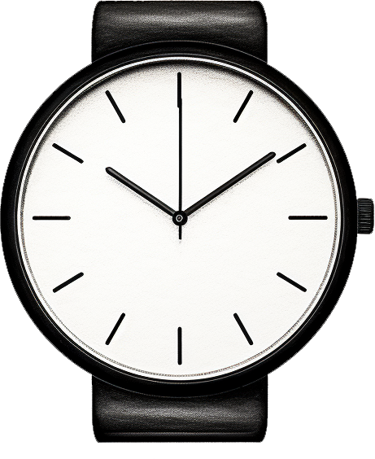
Time value of money (…)
In other words, if you have money in a savings account earning low interest, it’s not going to be worth as much in the future as it is today.
On the other hand, if you invest your money in something that has the possibility of earning a higher return, you might come out ahead.
To ensure that your money retains its value over time, the goal of investing is to earn a return that is higher than the rate of inflation. This way, your money will purchase more in the future than it does today.

Slide 37
3.2 Centralized control
How the government and banks manipulate the money supply
My First Bitcoin | Chapter 3

Slide 38
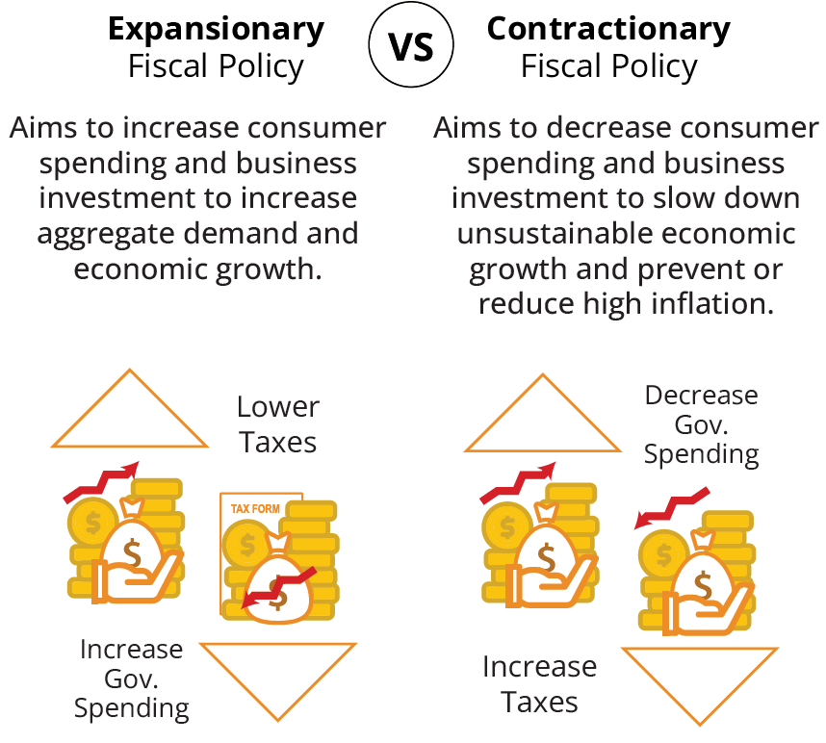
Centralized control
Governments use several tools to manage the money supply. For example, The Fed uses:
Monetary policy to adjust interest rates, affecting the amount of money in circulation.
Fiscal policy, which involves using spending and tax policies to influence economic activity.

Slide 39
Centralized control (…)
Exchange rate policies, supply shocks, and price controls are more tools that are used to manage the money supply and influence trade and the economy. These policies can help stabilize prices and manage inflation.
Grasping how these policies function is vital for understanding the limitations of centralized monetary systems and the context in which Bitcoin emerged.
As a decentralized currency, bitcoin addresses some of the issues associated with centralized control over the money supply by offering a system that operates independently of central authority.

Slide 40
3.3 The magic of money creation
My First Bitcoin | Chapter 3

Slide 41
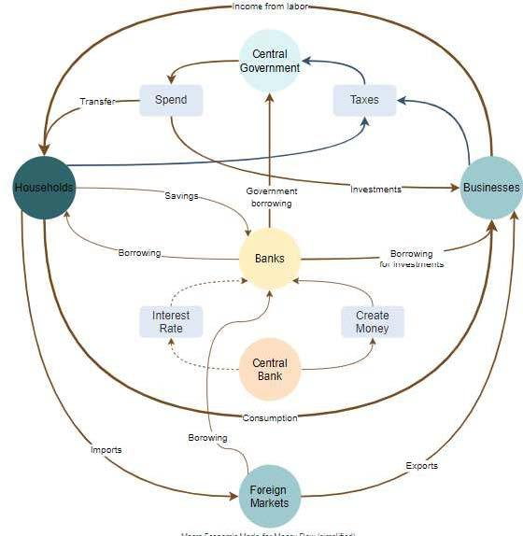
Money creation
How does new money enter circulation and fuel economic growth? Unlike physical resources like food or water, fiat money has no fixed limit. The government, the central bank, and private banks all play a role in this process.
Let’s take a closer look at how the Federal Reserve can add $100 million into circulation.

Slide 42
Money creation (…)
The Fed decides to increase the money supply by $100 million based on its monetary policy goals, such as boosting economic growth or stabilizing prices.
The Fed instructs a commercial bank to create a $100 million deposit in its account at the Fed, it is created out of thin air and not backed by anything.
When a commercial bank creates a deposit at the Fed, it essentially borrows money from the Fed.
The Fed provides the bank with funds for the deposit, and in return, the bank pays interest on the loan and eventually pays the loan back.

Slide 43
Money creation (…)
The bank uses the new $100 million deposit to make loans to businesses, individuals, or purchase securities such as government bonds.
The businesses or individuals who receive these loans can then use the money to make purchases, pay bills, or invest in other assets. This increases the overall supply of money in the economy.
The circulated money eventually ends up in other banks, which can then use it to make their own loans and investments. This process continues until the $100 million has been fully injected into circulation.

Slide 44
Money creation (…)
Excessive money printing can foster wealth inequality in several ways.
The Cantillon effect suggests that when new money is created, it benefits those who receive it first – usually large corporations and wealthy individuals.
These early recipients can spend or invest the new money before prices rise, accumulating more wealth.
In contrast, those further down the chain, like the middle and lower classes, experience the negative effects of inflation without reaping any direct benefits from the newly created money.

Slide 45
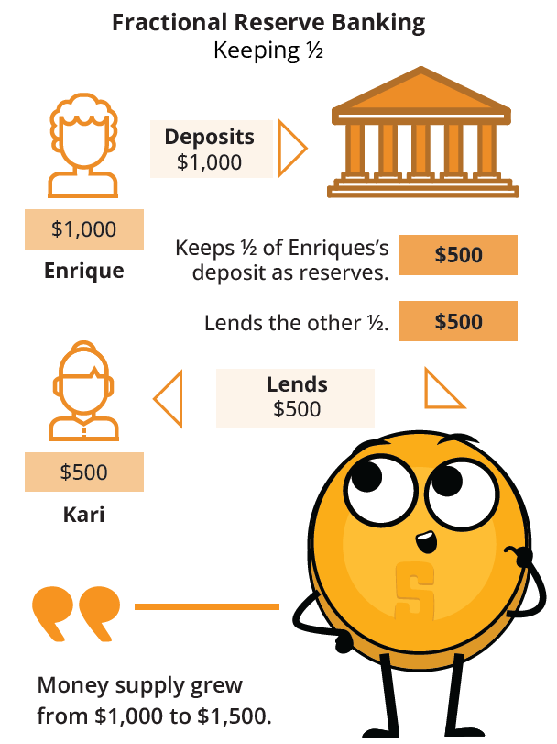
Fractional reserve banking
Fractional reserve banking is a system where banks maintain only a fraction of their deposits as reserves and lend out the remainder.
This ability to create new money carries the risk of excessive borrowing and financial instability if not managed carefully.
The reserve ratio is a regulation that dictates how much money banks must keep in reserve and how much they can lend out. It is established by the central bank, which is responsible for ensuring a healthy economy.

Slide 46
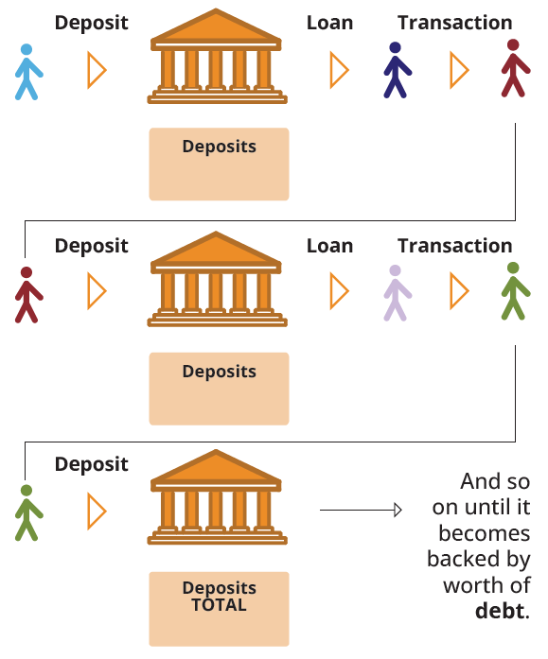
Fractional reserve banking (…)
Andy just won $100,000 from the lottery and deposits it in the bank. With a 10% reserve ratio, the bank must keep $10,000 in its vault and can lend out the remaining $90,000.
Charlie borrows the maximum amount ($90,000) and uses it to buy a house from Dan.
Dan deposits the $90,000 from Charlie into the bank. Total deposits in the bank are now $190,000.
Eric requests a loan and the bank lends out 90% of the new deposit, which is $81,000.
Eric uses the $81,000 loan to buy an art piece from Frank, who then deposits the money in the bank. The total deposits recorded are now $271,000.

Slide 47
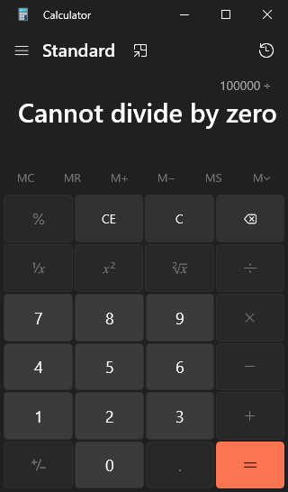
Fractional reserve banking (…)
The formula is: Money Created = Total Amount of Money ÷ Reserve Ratio
If the reserve ratio were lowered to 1%, the amount of money created would be significantly higher:
$100,000 ÷ 0.01 = $10,000,000
As of 2020, the U.S. Federal Reserve reduced reserve requirement ratios to zero percent in order to stimulate the economy.

Slide 48
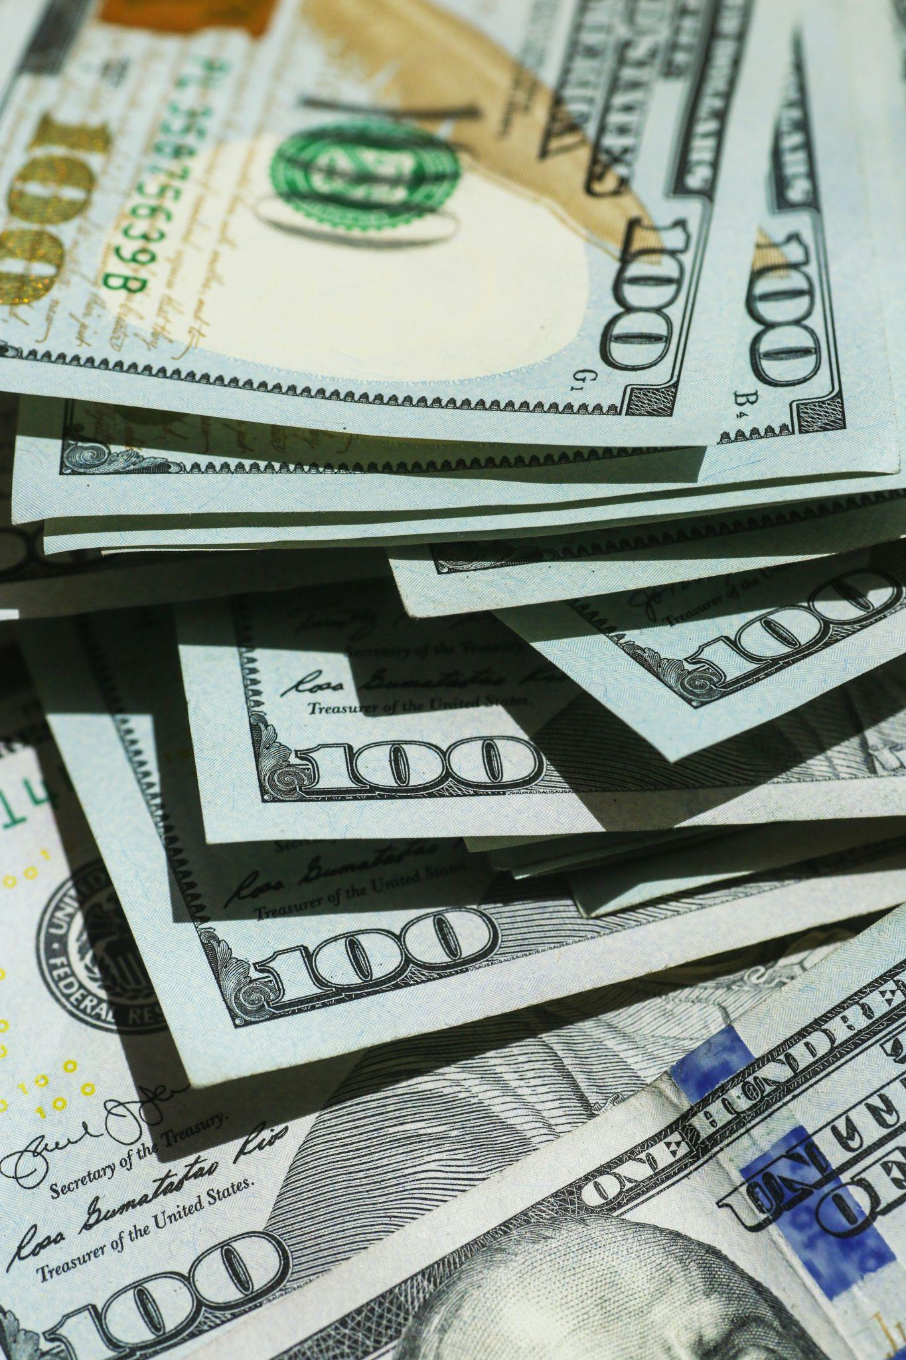
Conclusion
Through this exercise, we can see that fractional reserve banking has the potential to fuel economic growth by increasing the availability of credit.
However, it carries massive risks that need to be carefully managed to avoid inflation and financial instability.
Photo by Giorgio Trovato on Unsplash

Slide 49
3.4 Debt: The inequal burden
My First Bitcoin | Chapter 3

Slide 50
Debt: The inequal burden
Debt is money that is owed by one person or organization to another.
When you have debt, you are required to pay back the money you owe, usually with interest, by a certain date.
Debt is a double-edged sword. Borrowing money can provide a much-needed financial boost for individuals, businesses or governments, but borrowing too much can lead to financial ruin.
When you can’t pay the interest on your debts, it becomes harder to pay your bills and stay afloat.
Taking on more debt to pay off existing debt can result in a vicious cycle known as a debt spiral.

Slide 51
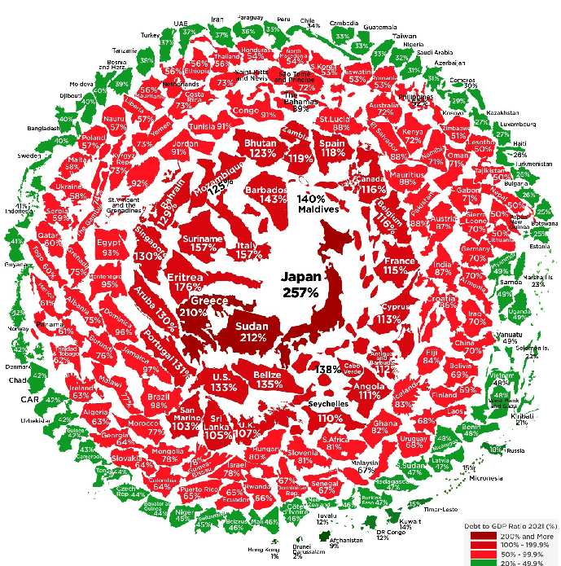
Debt: The inequal burden (…)
The debt crisis is a worldwide problem, including in the United States. Currently, the government is spending more money than it is earning. To pay its bills, it has been borrowing more and more money.
However, this cycle of debt and higher borrowing costs can soon harm the government’s credit rating. If the debt becomes too much, the government may have financial difficulties and potentially go bankrupt, just as many other countries have in the past.

Slide 52
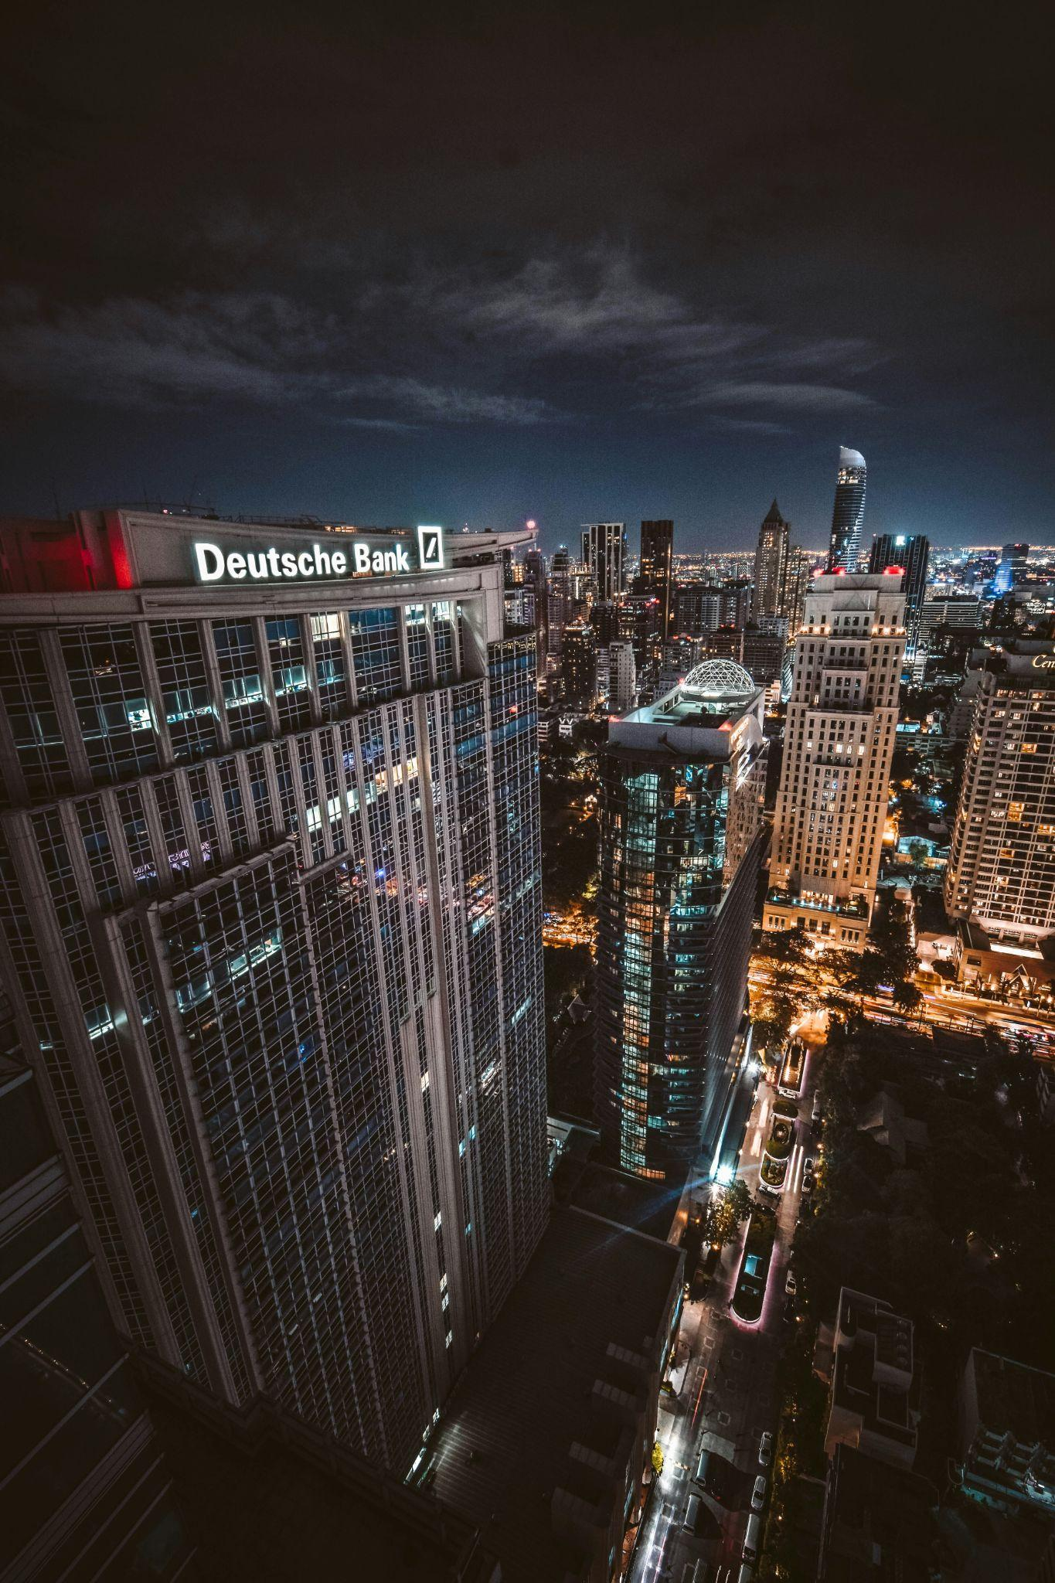
Debt: The inequal burden (…)
In the late 2000s, Greece faced a severe debt crisis when it was revealed that the government had been hiding the true extent of its debt.
As a result, the country was unable to repay its creditors, leading to austerity measures, unemployment, and a significant decline in economic growth.
Photo by Tan Kaninthanond on Unsplash

Slide 53
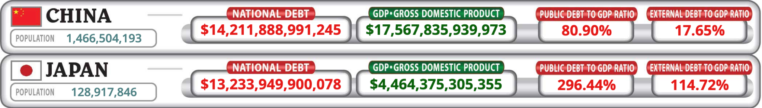
Debt: The inequal burden (…)
How can we measure the risk of a country taking on too much debt?
One way is the debt-to-GDP ratio, which shows the amount of a country’s total debt as a percentage of its GDP.
Gross Domestic Product (GDP) is a measure of the total value of goods and services produced within a country over a period of time, typically a year.
Source: usdebtclock.org

Slide 54
Debt: The inequal burden (…)
It’s important to remember that the debt-to-GDP ratio is only one part of understanding a country’s money situation.
The ratio is a way to determine if a country will be able to pay its debts.
If the ratio is high, the country may have trouble paying its debts in the future.
If the ratio is low, the country may be able to pay its debts easily and be in good financial shape.
Source: usdebtclock.org

Slide 55
3.5 Addressing wealth inequality
My First Bitcoin | Chapter 3

Slide 56
Addressing wealth inequality
The transition from commodity-based currencies to the fiat system brought about several challenges. Issues with the current monetary system include:
Inflation
Debasement
Excessive debt
Wealth inequality
Privacy risks
Financial censorship
Concerns about control
The need for a viable alternative is increasingly urgent in today’s digital, interconnected world.
Bitcoin was invented as a potential solution to these issues with fiat.
Operating independently of central banks, Bitcoin enables peer-to-peer transactions without intermediaries, making it a groundbreaking innovation in the financial industry.

Slide 57
Addressing wealth inequality (…)
Key features of Bitcoin include its decentralized network, which makes it resistant to government interference and manipulation, and its finite supply.
These attributes make bitcoin scarce and valuable, similar to gold, contributing to its growing popularity as a store of value and investment opportunity.
A key benefit of Bitcoin is that it operates without a central authority.
Nobody controls Bitcoin, and it has been operating since January 3, 2009, without any major disruptions or shutdowns.

Slide 58
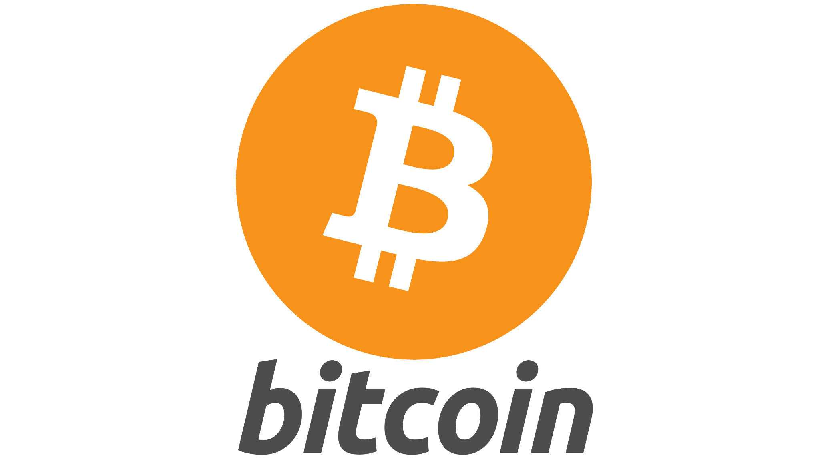
Addressing wealth inequality (…)
The decentralized nature of Bitcoin means that it is not subject to the same vulnerabilities as centralized systems, which can be manipulated or controlled by governments, banks, or other institutions.
This lack of control has also been a major factor in addressing wealth inequality, as Bitcoin is accessible to anyone with an internet connection, regardless of their socioeconomic status.
In following chapters, we’ll explore Bitcoin’s origins, the technology, and how it addresses the concerns of the current monetary system.

Slide 59



Material adapted from Mi Primer Bitcoin’s Bitcoin Diploma, with gratitude by Bitcoin Ubuntu.
As presented online by Bitcoin Ubuntu on behalf of The Core.

